Slide 1
e - Conductor V2.0
Department of Computer Engineering
Faculty of Engineering
University of Peradeniya
Sri Lanka

Slide 2




e-Conductor

Slide 3



OUR TEAM
E/20/032
BANDARA A.M.N.C.
E/20/035
BANDARA K.C.H.N.A.W.M.R.C.J.N.
E/20/133 HATHTHELLA H.A.D.T.N.
E/20/157
JANAKANTHA S.M.B.G.

Slide 4
e-Conductor

Slide 5
OUR TEAM
SUPERVISOR
Prof. Manjula Sandirigama
E/20/032
Bandara A.M.N.C.
E/20/035
Bandara K.C.H.N.A.W.M.R.C.J.N.
E/20/133 Haththella H.A.D.T.N.
E/20/157
Janakantha S.M.B.G.

Slide 6
e-Conductor

Slide 7
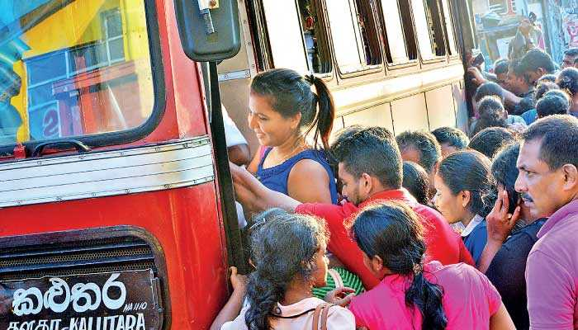
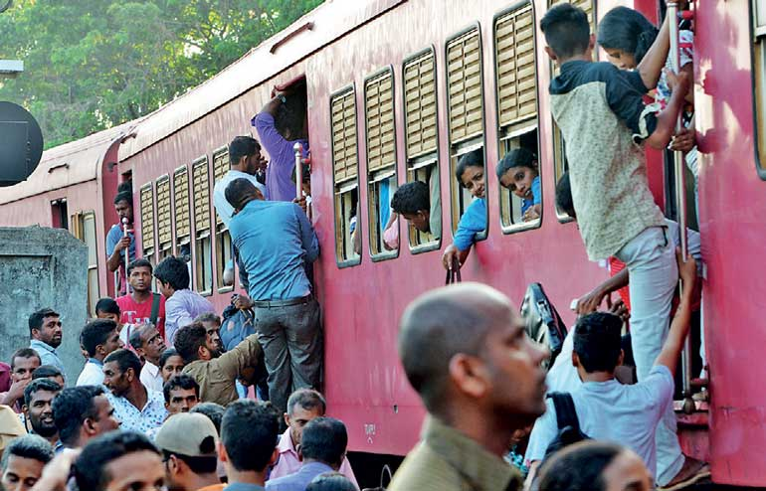
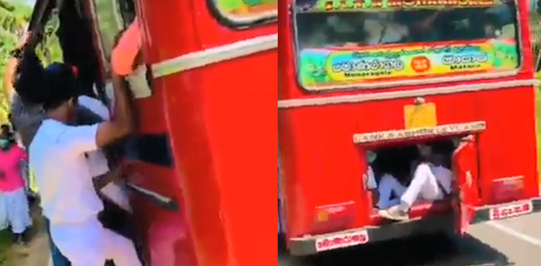
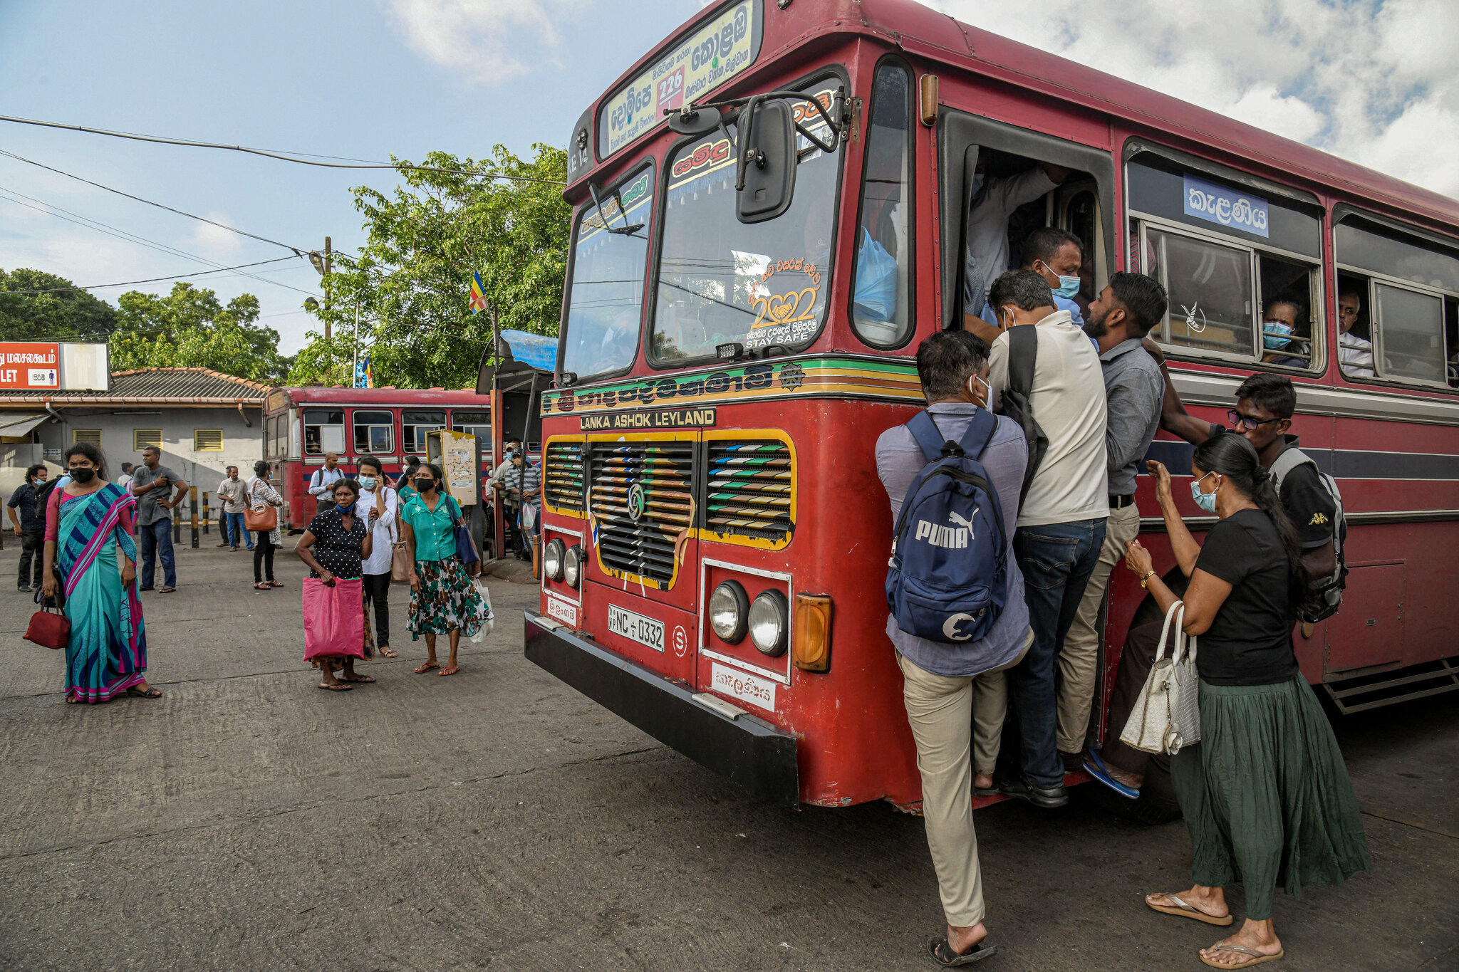
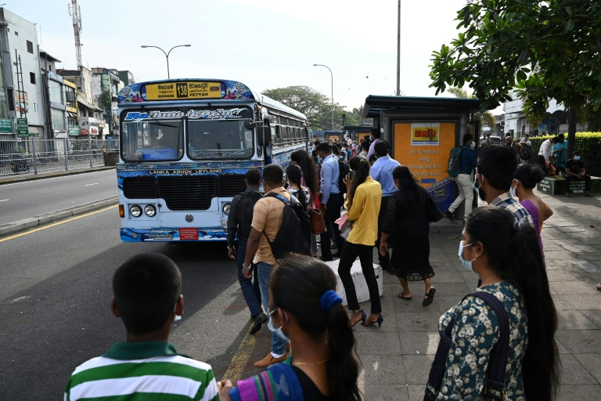
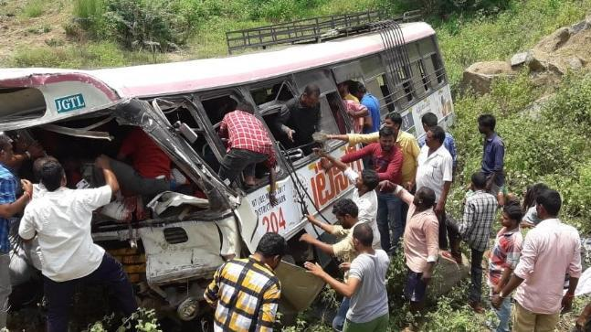
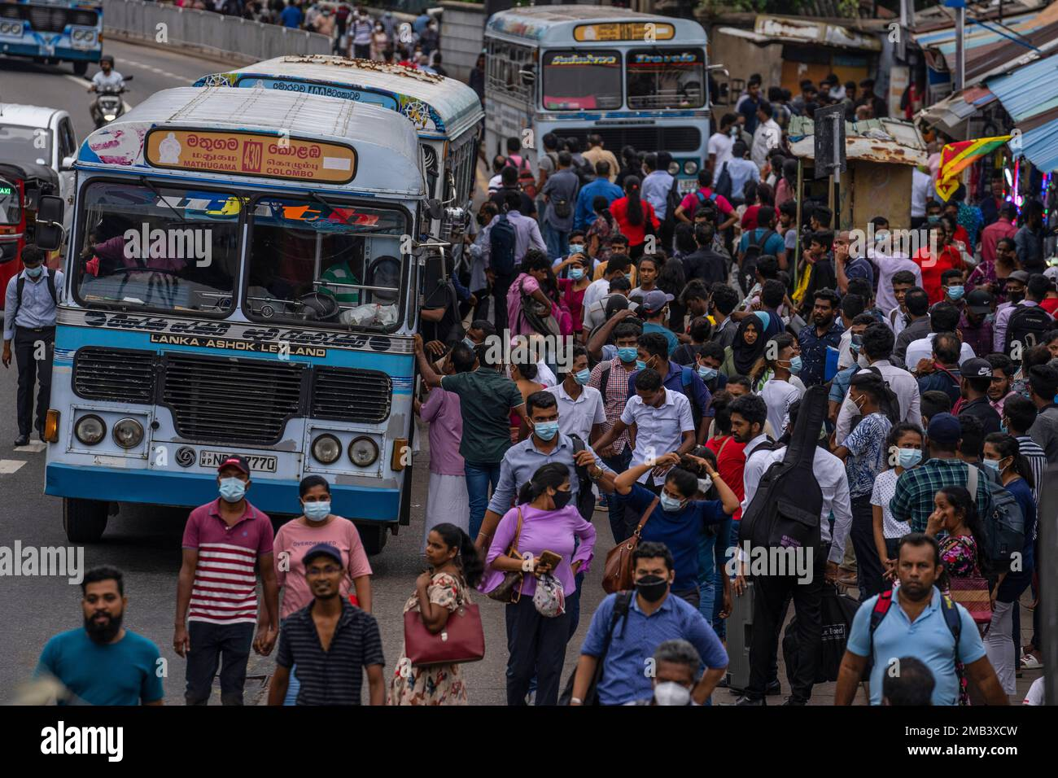



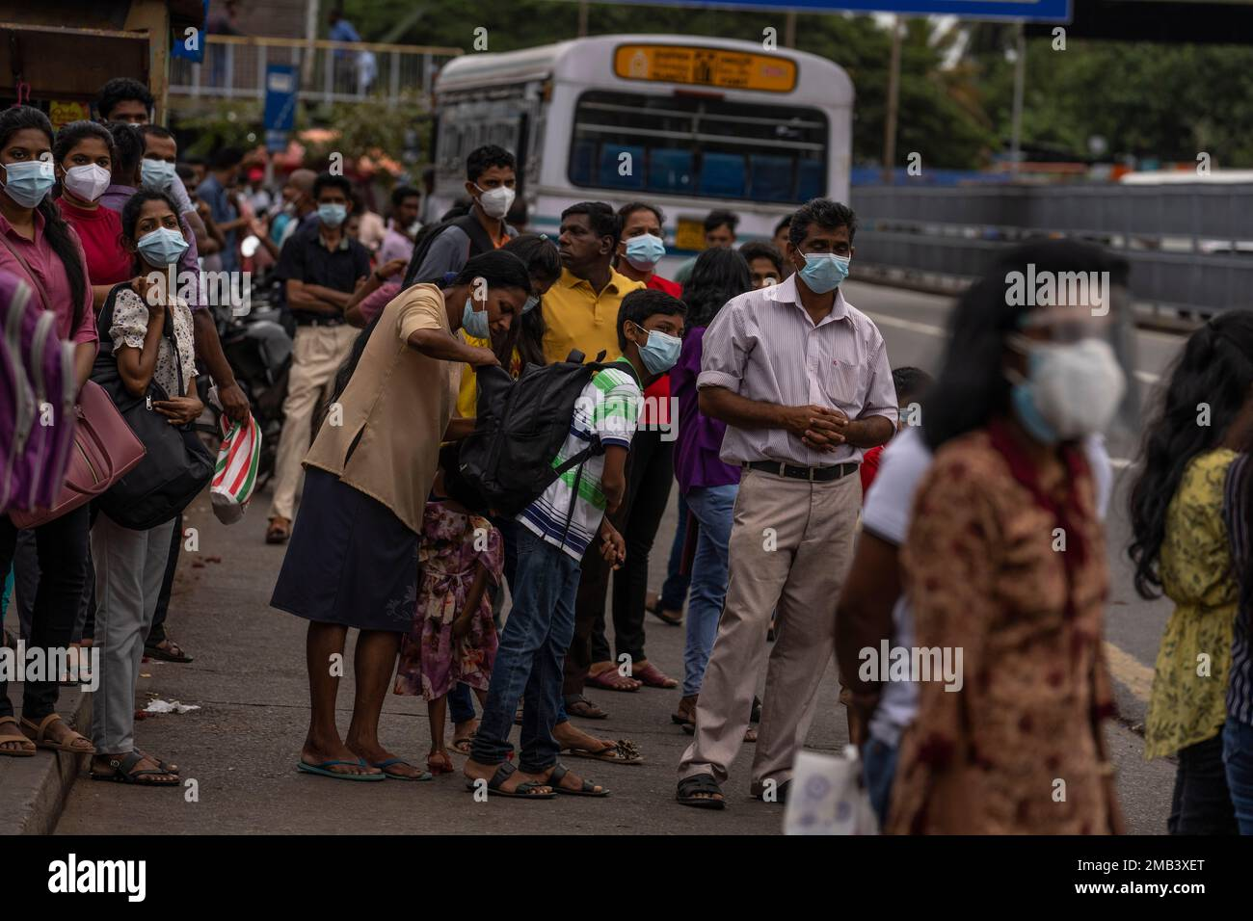
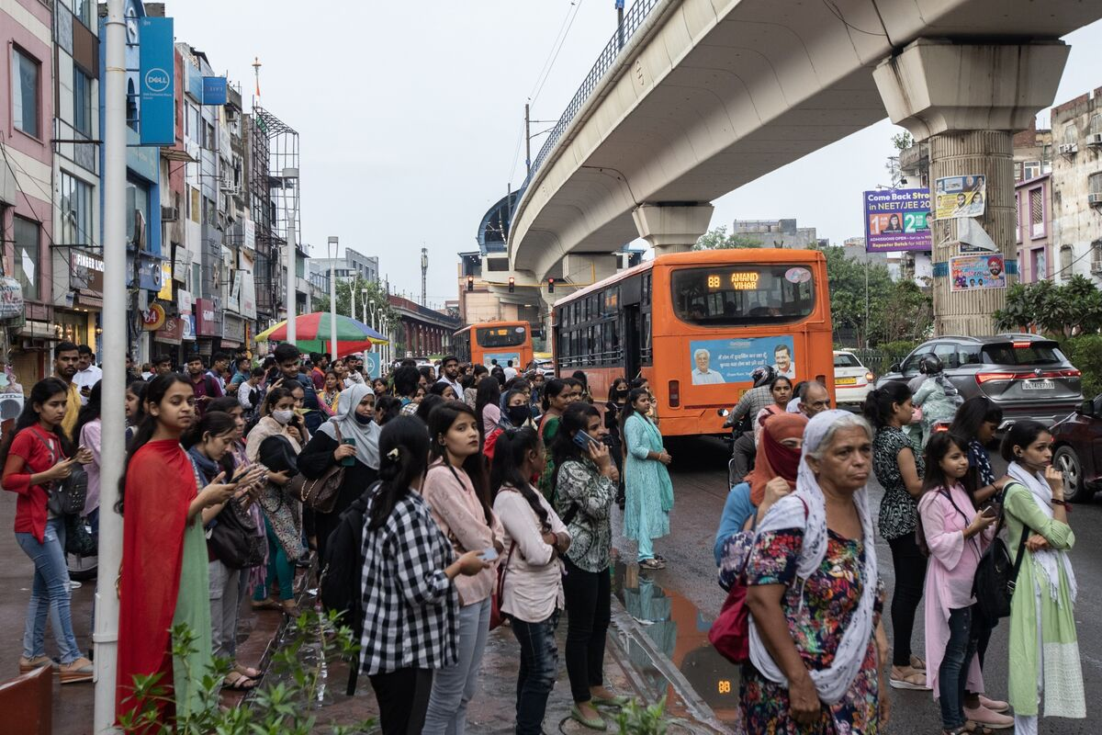
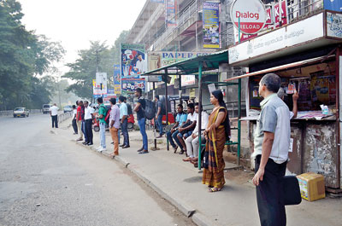
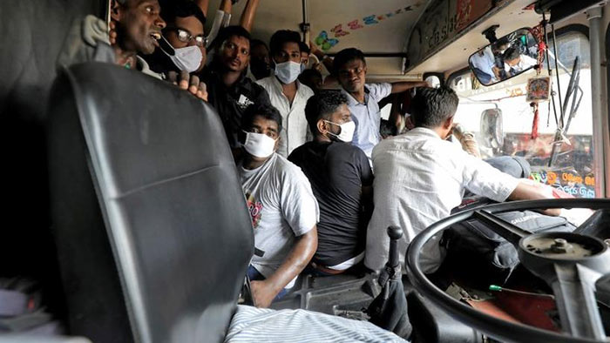



THE PROBLEM
Waiting in long queues
No method to find availability of busses
Overcrowded busses
Issues on getting balance
Shift to alternative methods

Slide 8
e-Conductor

Slide 9
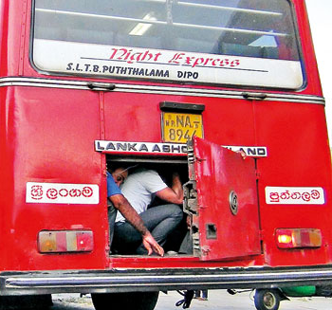
THE PROBLEM
Waiting in long queues
No method to find availability of busses
Overcrowded busses
Issues on getting balance
Shift to alternative methods

Slide 10
SAMPLE TEXT
POINT 1
POINT 2
POINT 3
POINT 4
POINT 5

Slide 11
e-Conductor

Slide 12
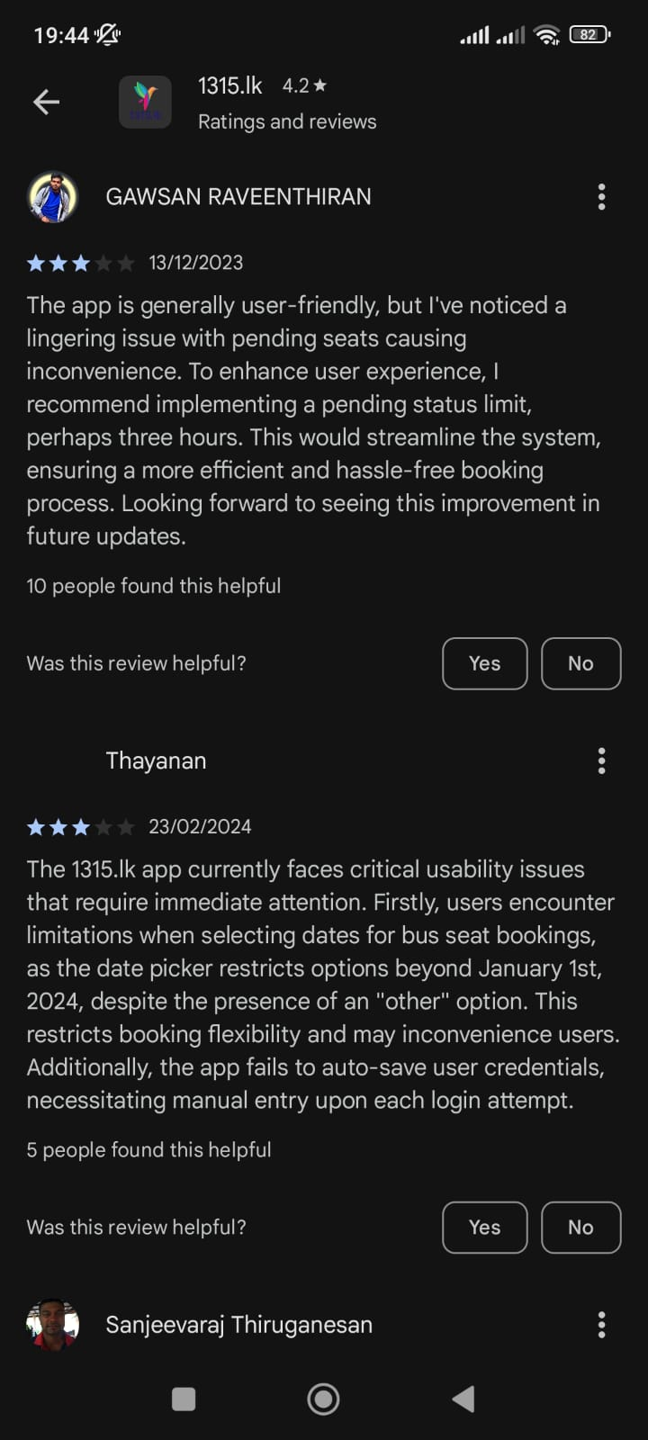
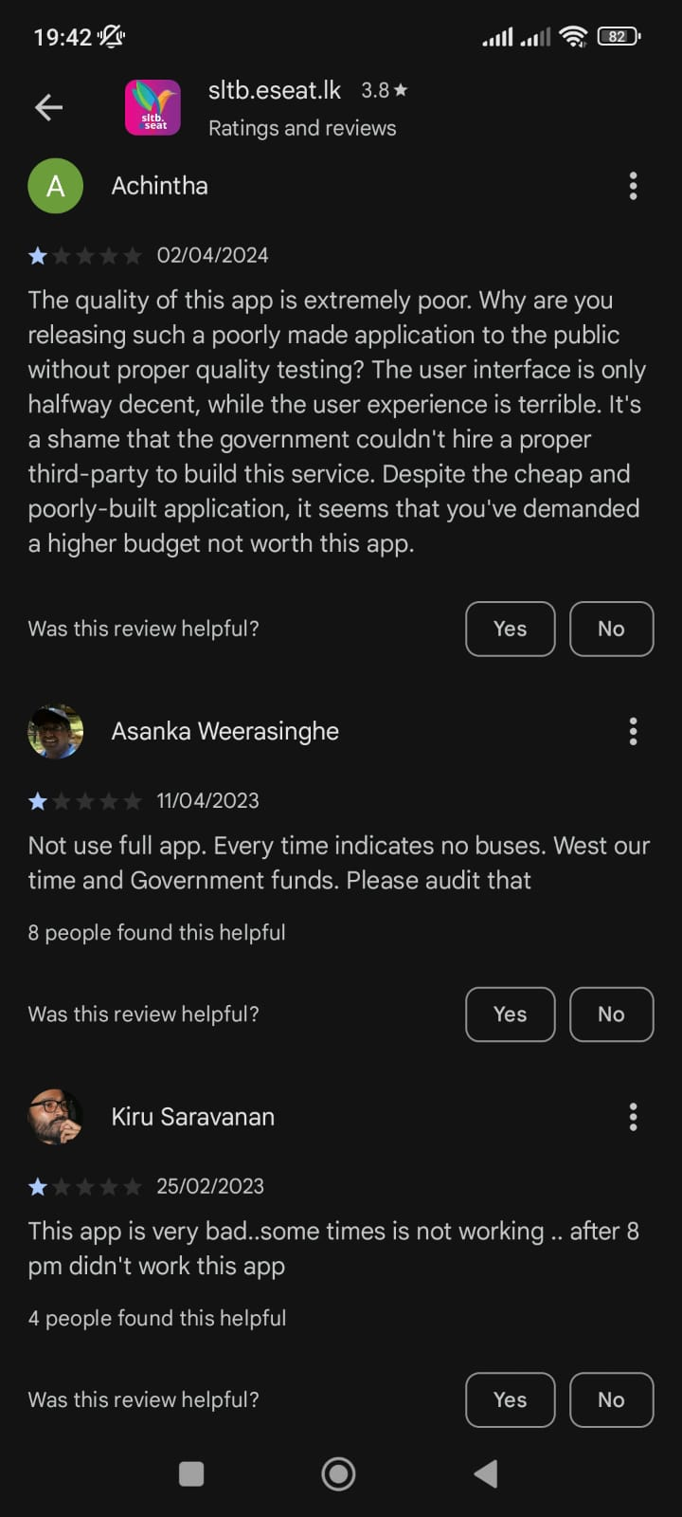
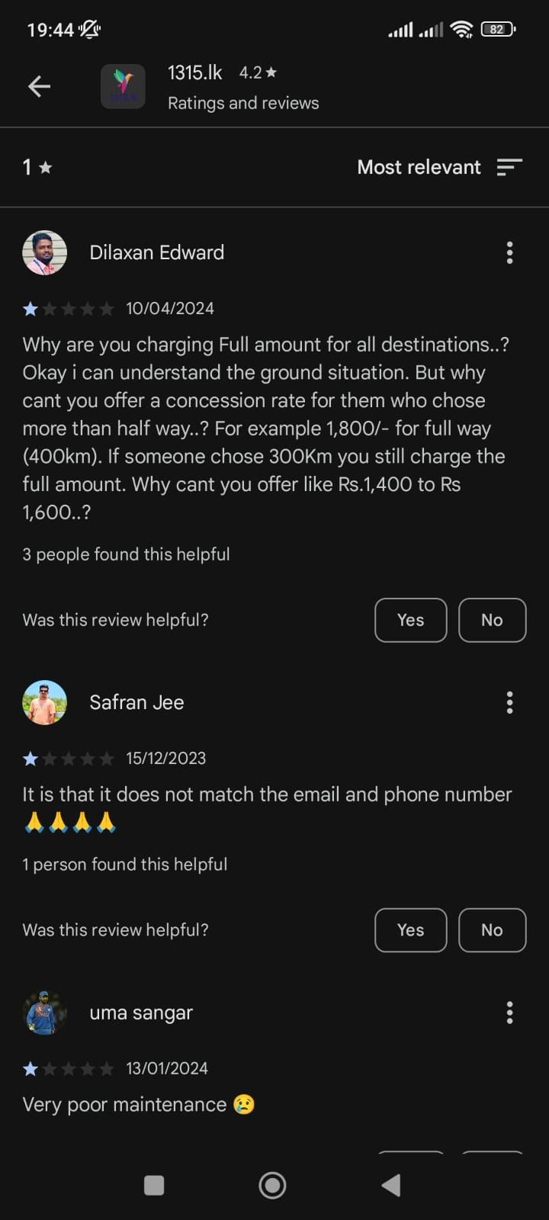
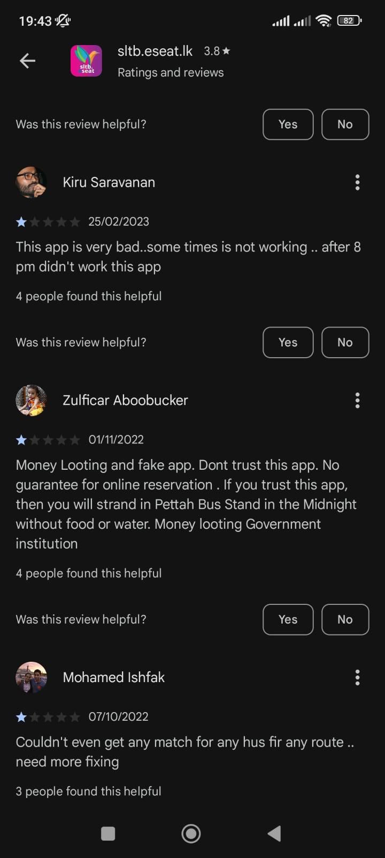
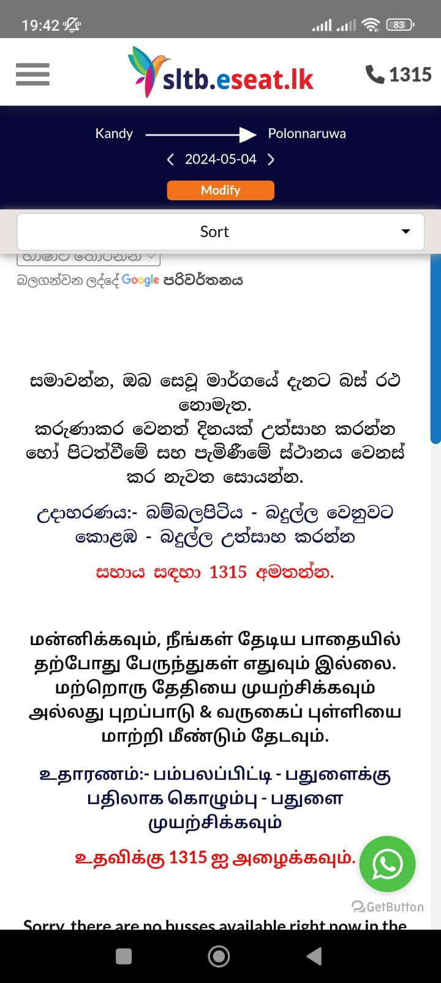
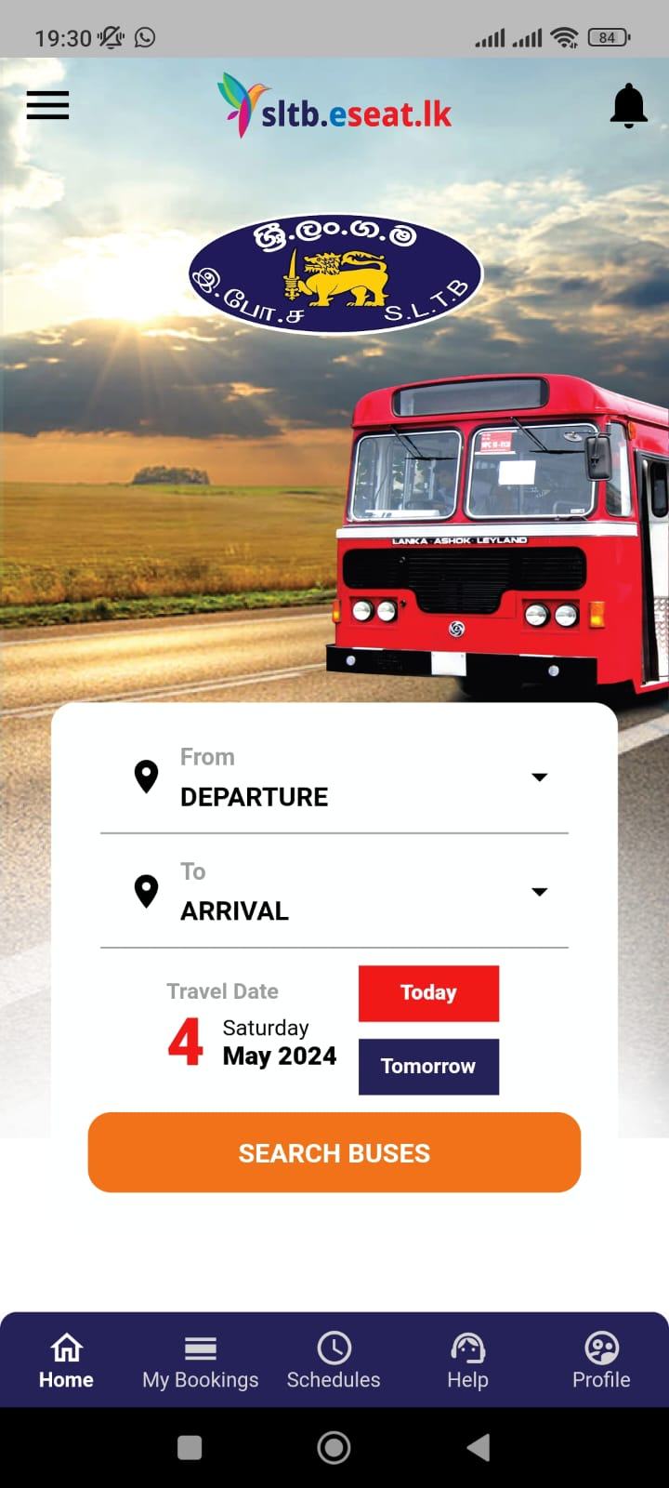
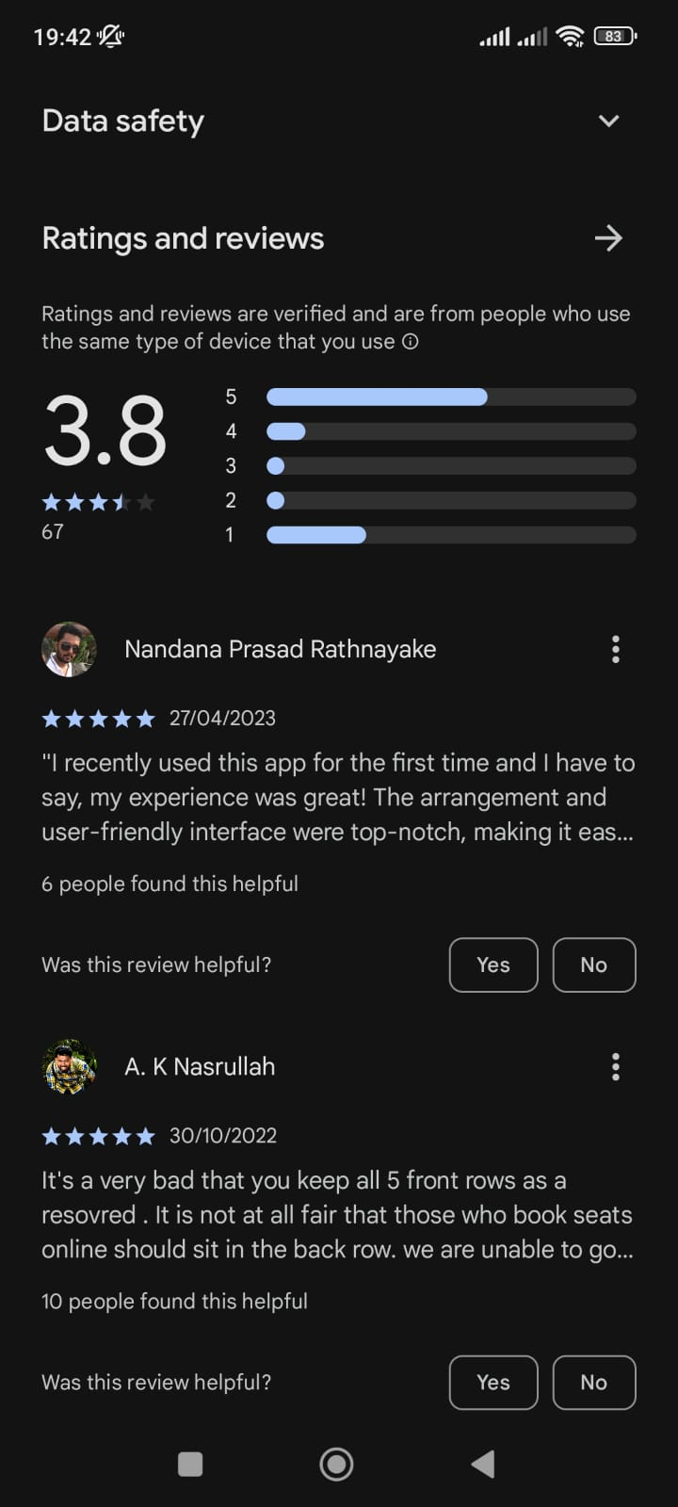




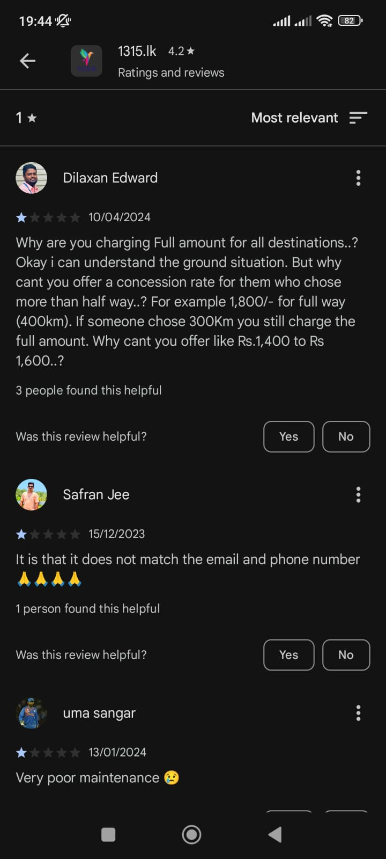
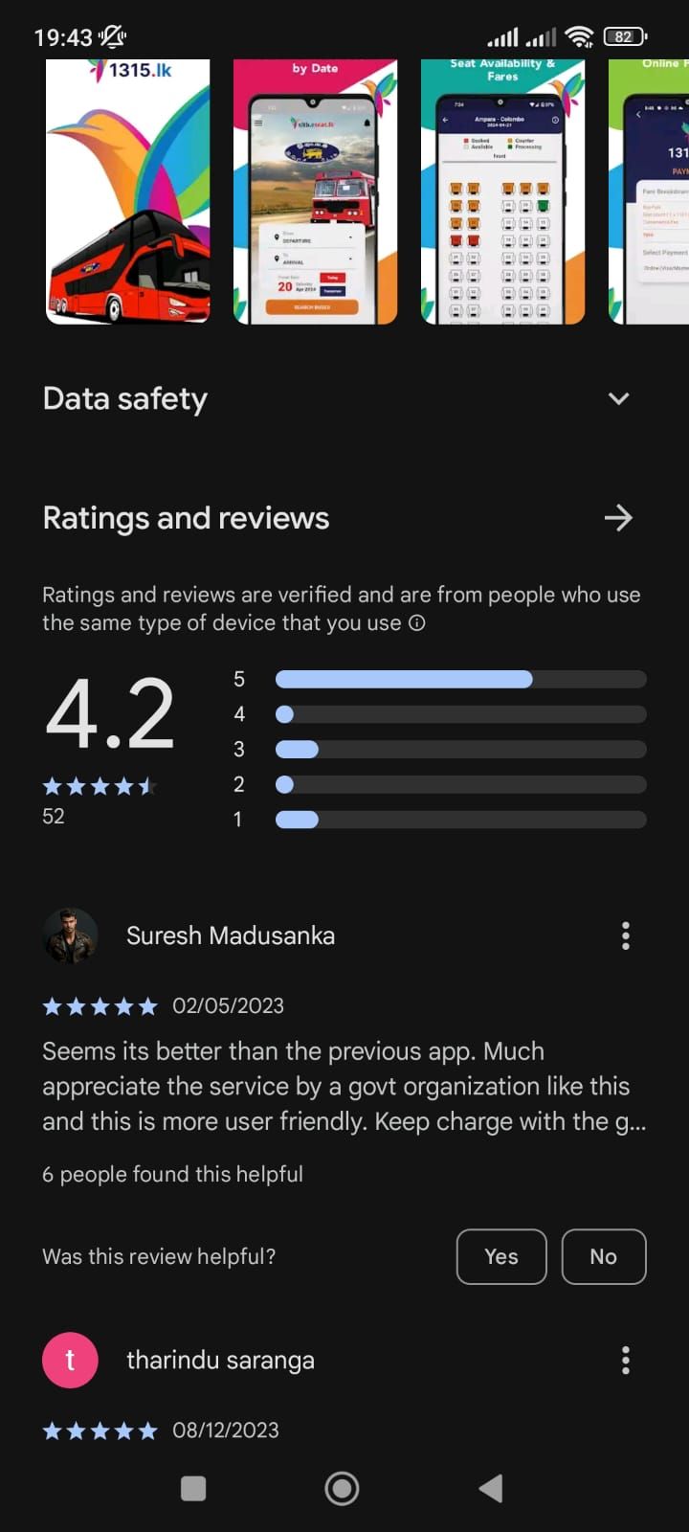
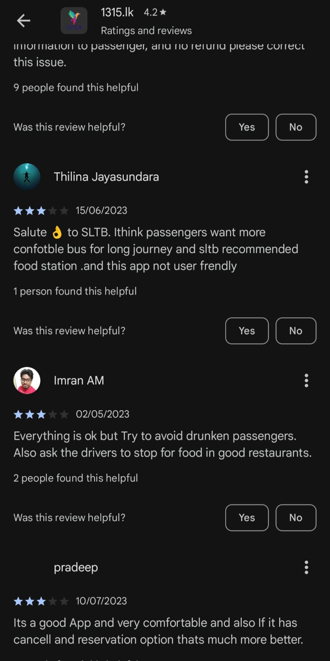

CURRENT SOLUTIONS
No method for tracking busses
Payment and booking are not guaranteed
Contact details are not available
Schedules are outdated
No Methods for complains

Slide 13
e-Conductor

Slide 14
CURRENT SOLUTIONS
No method for tracking busses
Payment and booking are not guaranteed
Contact details are not available
Schedules are outdated
No Methods for complains

Slide 15
e-Conductor

Slide 16
OUR SOLUTION

Slide 17
e-Conductor

Slide 18







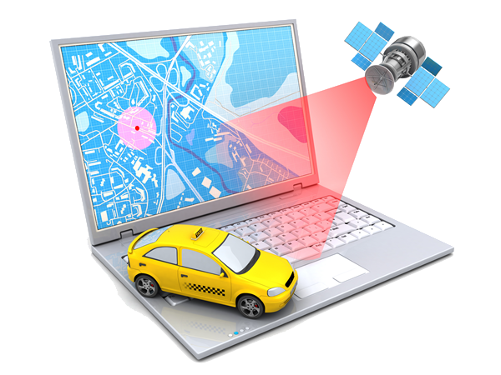
OUR PLAN
Web App
Mobile App
Database
Testing & Debugging
Payment Gateway
App Launching
Fastest Path Algorithm
Live Location Tracking

Slide 19
e-Conductor

Slide 20
THANK YOU

Slide 21
Thank you!
Thank you!

